Slide 1
BELIMO | FIELD TRAINING
Energy Valve
Coil Estimator
One coil, five steps, and a defensible pumping-savings number — plus what the financial results actually mean.
Rick Smith · Team Lead Regional Applications Consultant
Belimo Americas · Internal training

Slide 2
Why a coil runs at the wrong Delta-T
And why that shows up on the electricity bill.
A coil is selected for a design temperature rise. Most run below it — and to move the same heat at a lower Delta-T, the pump has to push more water.
That is the whole opportunity. An Energy Valve holds the Delta-T you ask for, so the flow comes down — and pump power falls much faster than flow does.
THE CUBE LAW
Cut flow by a third
→ pump power falls ~70%
Pump power varies with roughly the cube of flow.
This tool counts pumping savings only. Its companion, the Savings Estimator, models a whole plant and adds the chiller side. Coil conversation → this tool. Central plant → that one.
1

Slide 3
Five tabs, one of which you fill in
The rest calculate or present.
1
2
3
4
5
Home
›
Pump Savings
›
Flow Curves
›
Charts
›
Results
Everything you type — 5 steps
The calculation engine
Reference curves
The same, plotted
What you present
You only ever type on Home. One field on Pump Savings is editable; everything else is calculated or reference.
Results is the page you put in front of the customer.
2

Slide 4
1
Filling it in
The Home tab is a wizard — five numbered steps, top to bottom.

Slide 5
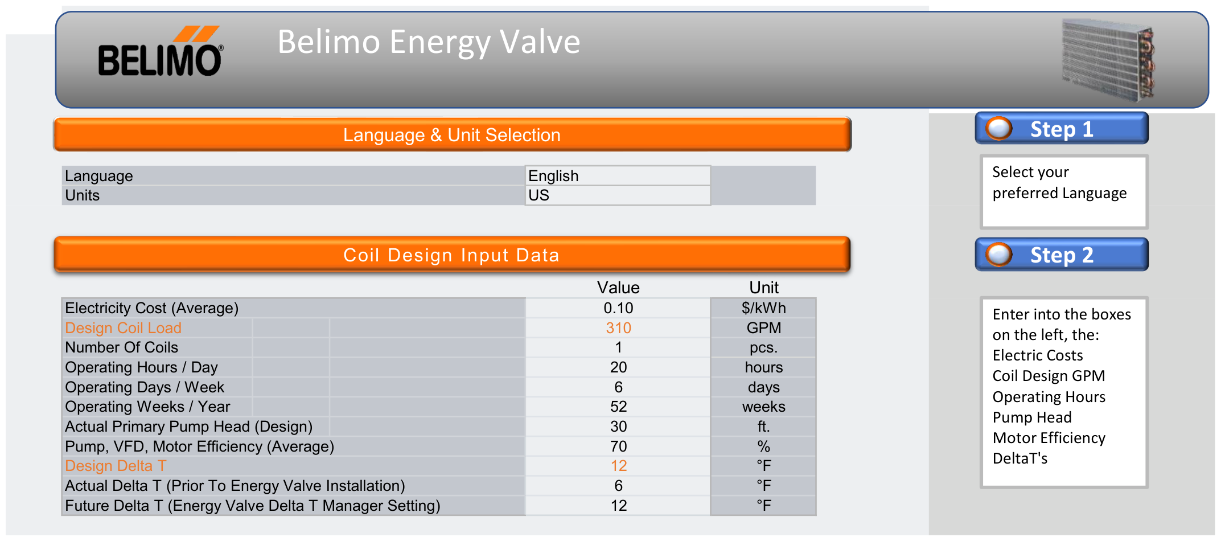
Steps 1 and 2
Language and units, then the coil itself.
Follow the blue callouts
Every orange band has a numbered Step callout beside it telling you what belongs in that block. Work down the page and the tool does the rest.
Shading is the key. Pale cells are yours to type in. Blue-grey cells are labels or results and are protected — if it will not accept typing, it is a result.
3

Slide 6
The coil design inputs
Eleven values. Everything downstream is built from them.
Electricity cost $/kWh — blended all-in rate
THE TWO THAT DRIVE EVERYTHING
Design coil load GPM — this is a FLOW, not a tonnage
Actual Delta-T
Number of coils fixed at 1 — one coil at a time
What the coil achieves today — the “before” case.
Operating hours / day
Future Delta-T
Operating days / week
What the Energy Valve will hold — the “after” case.
Operating weeks / year
Primary pump head ft. at design flow
Pump, VFD, motor efficiency % wire-to-water
The tool enforces a minimum gap between the two, so the pair always makes physical sense.
Watch the label: “Design Coil Load” is in GPM.
4

Slide 7
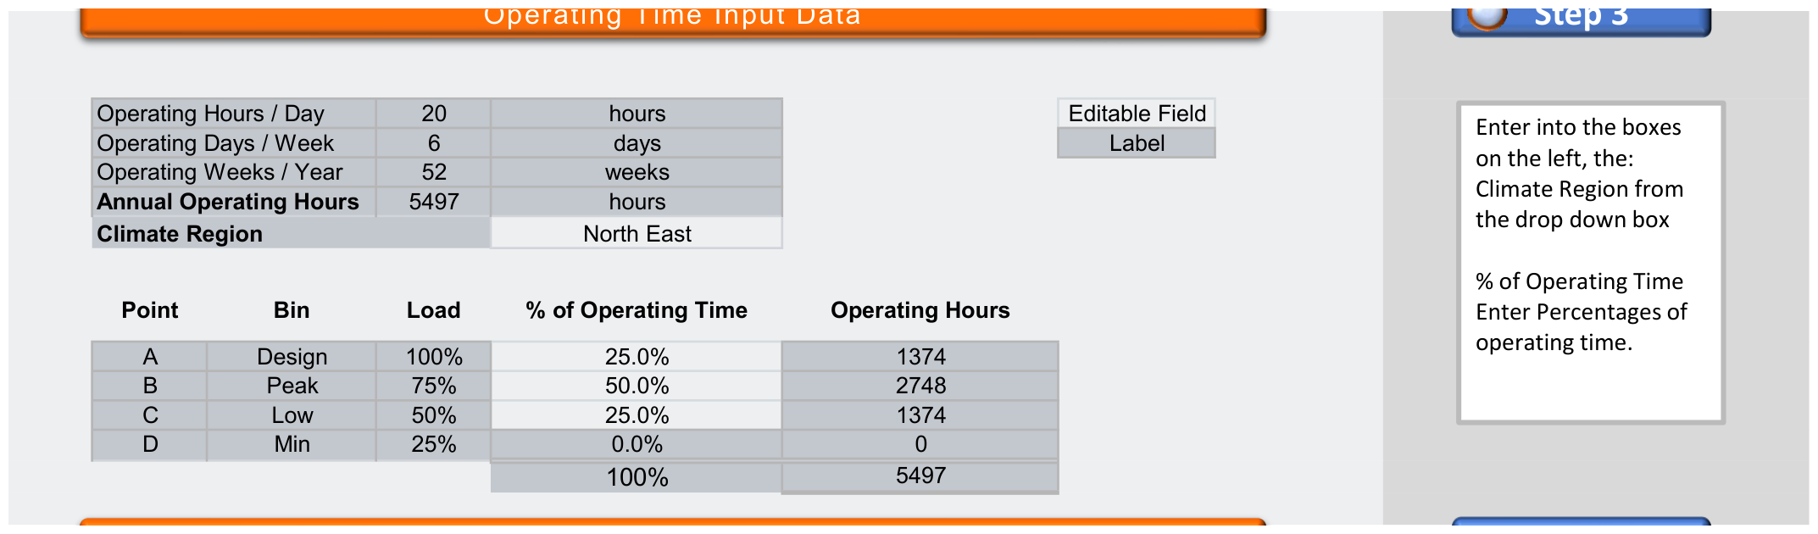
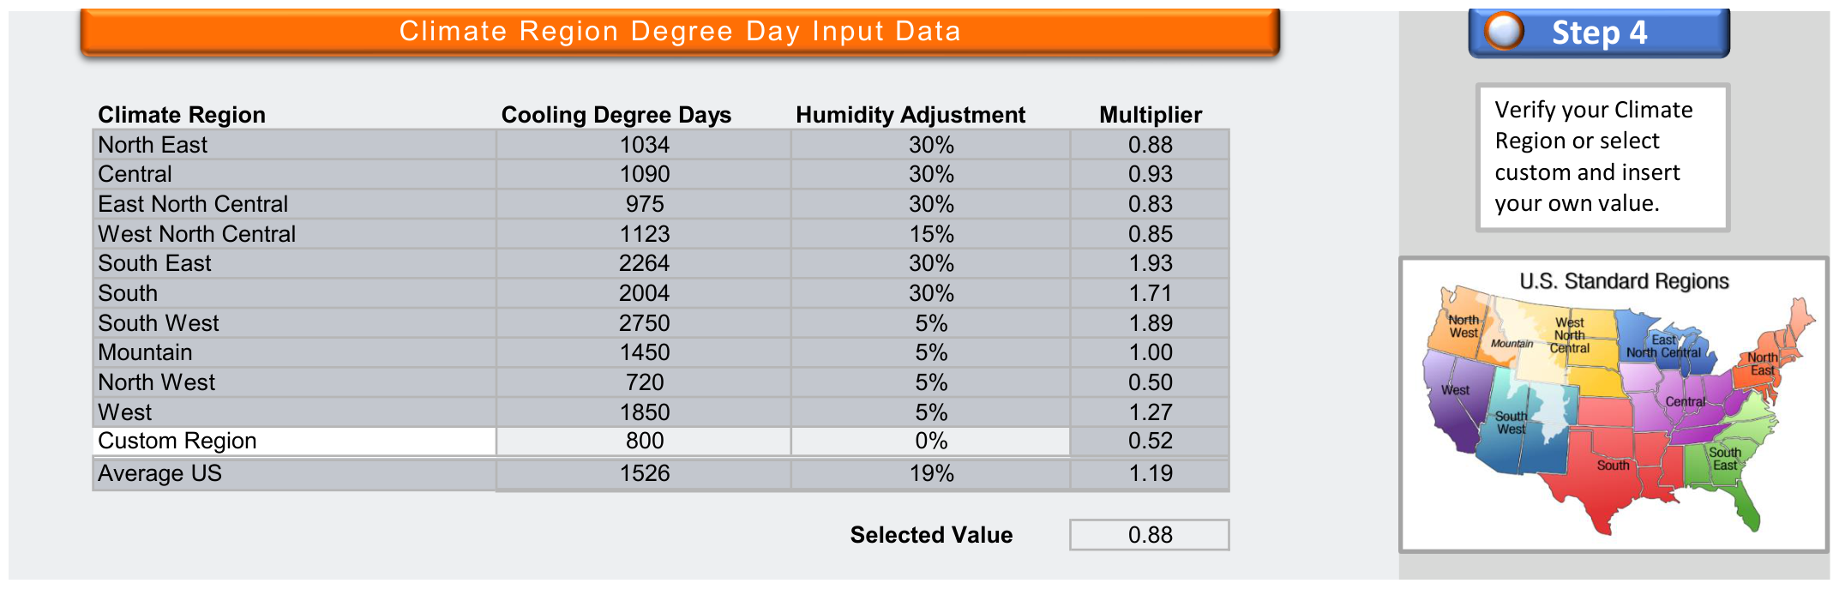
Steps 3 and 4
Operating time, then the climate profile.
Four load points, not 8,760 hours
Annual hours come from your three entries, then split across four representative points — Design, Peak, Low and Minimum. Only the share column is editable and the four must total 100%.
Change the split only with a reason. The defaults are sensible. If you have trend data from the building system, use it — otherwise leave them alone.
Climate region
Pick your region for its cooling-degree-day profile, or use Custom Region to enter your own figures for a site that fits none of them.
5

Slide 8
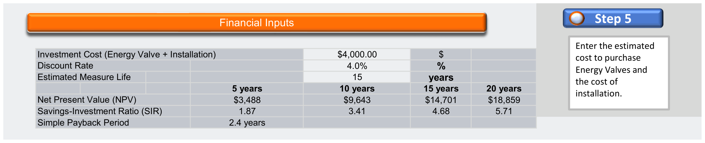
Step 5 — the financial inputs
Three entries, and the three results they drive.
Investment cost
Discount rate
Estimated measure life
Energy Valve plus installation — the INCREMENTAL cost over the valve that would have been fitted anyway.
Converts future dollars into today's. Your organisation's required return.
How long it keeps saving. Feeds the lifetime figures on Results.
“Incremental” is the word that matters — not the whole valve package.
6

Slide 9
2
What the engine does
You never edit it, but you should be able to explain it.

Slide 10
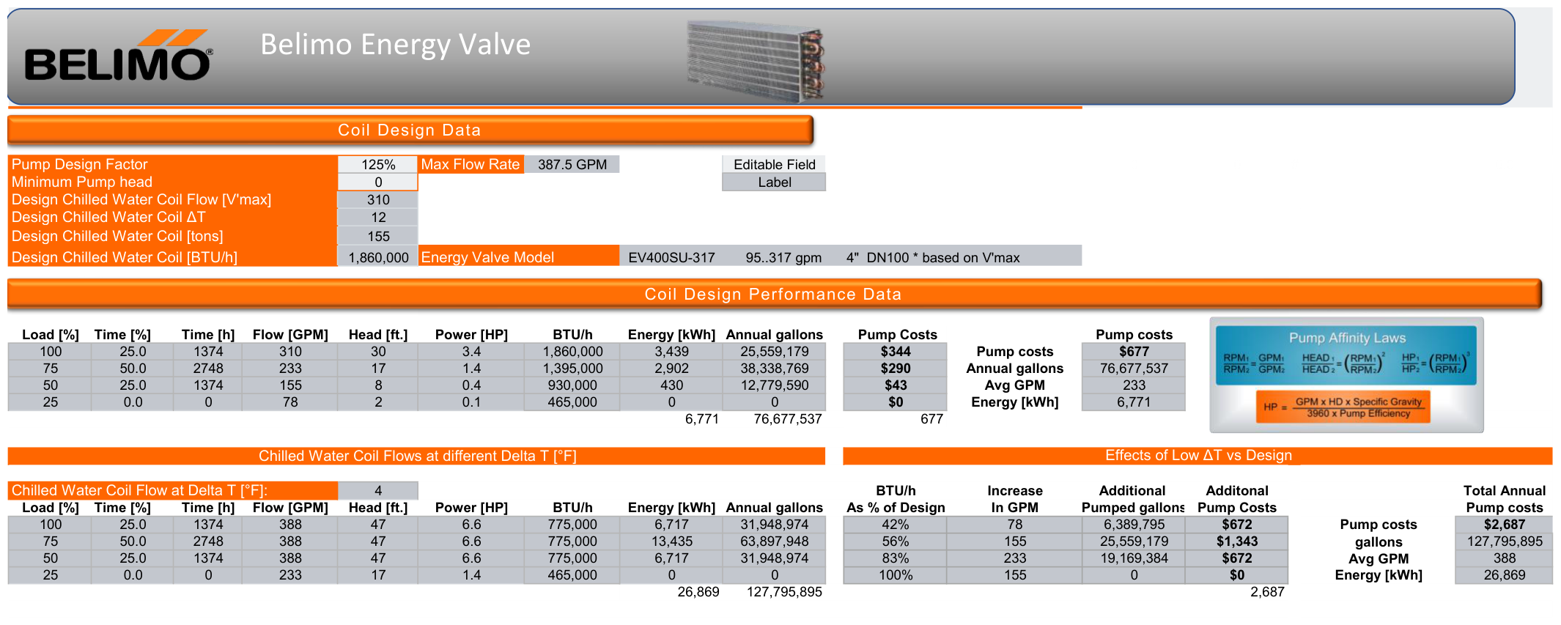
Pump Savings tab
One calculation block per Delta-T.
How a block reads
For each of the four load points it works out the flow needed at that Delta-T, the head the pump sees at that flow, the resulting power, and — from the hours in that bin — the energy and the cost.
One editable cell: the Pump Design Factor. It is how much bigger the pump is than the coil needs. Leave it unless you know the real oversizing.
Add the four rows and you have that Delta-T's annual pumping bill.
7

Slide 11
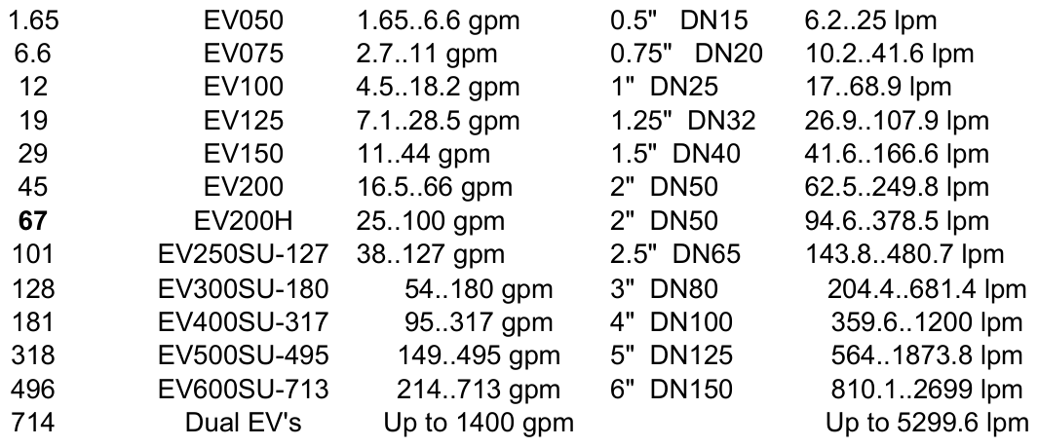
It also picks the valve
Matched to the design flow you entered in Step 2.
The tool reads your design flow, finds the Energy Valve model whose capacity covers it, and shows that model with its flow range.
The range follows your unit setting. Switch to Metric and the capacities are shown in litres per minute instead of gallons.
Useful in the room: it turns “an Energy Valve” into a specific model number you can quote against the coil in front of you.
8

Slide 12
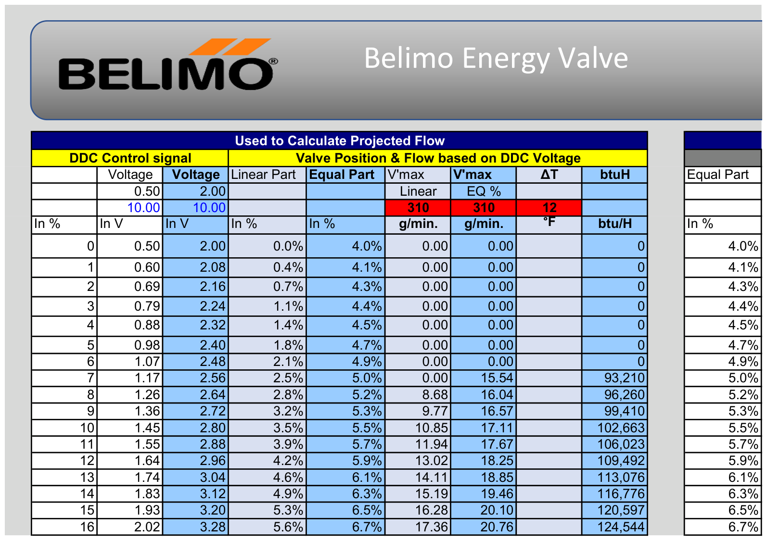
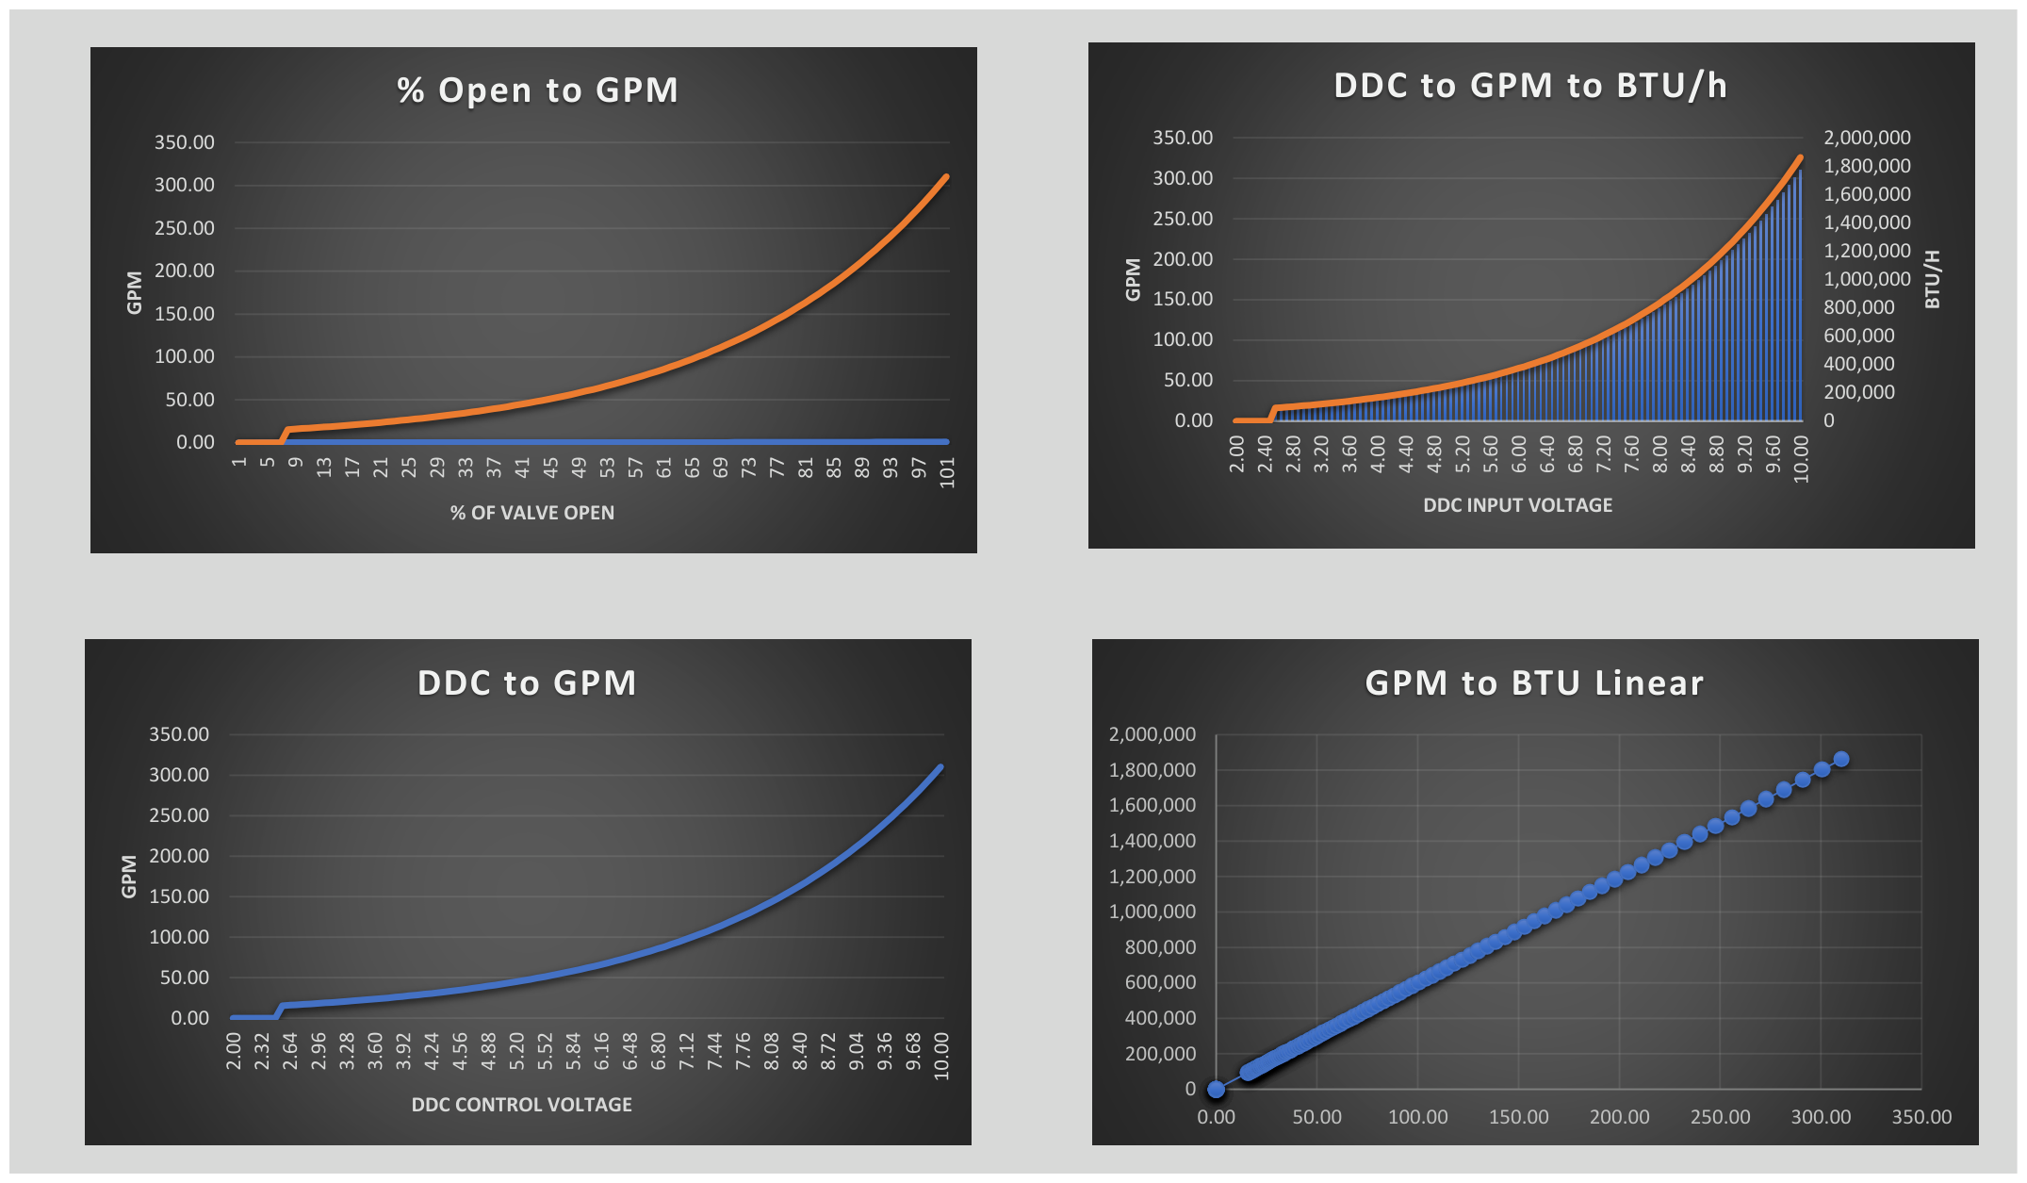
Flow Curves and Charts
Reference material for the technical conversation.
Nothing to fill in on either tab. They show how a control signal maps to valve position and flow — useful when a controls contractor asks, but not part of the savings calculation.
9

Slide 13
3
The financial results
Three numbers, four horizons — and the one people misread.

Slide 14
First, the idea behind all three
Money later is worth less than money now.
The discount rate is a lever
PRESENT VALUE
Raise it and future savings count for less, so the first two results below both get smaller. Lower it and they grow.
A dollar saved in year eight is not worth a dollar today — you could have invested today's dollar in the meantime. Present value is what a future amount is worth now, once discounted back at the rate you set in Step 5.
It is not a fudge factor. Set it to what your organisation actually requires, and leave it there.
Everything on the next two slides is built on this one idea.
10

Slide 15
The two discounted results
Both answer “is this worth doing?” — in different units.
RESULT 1
RESULT 2
Net Present Value (NPV)
Savings-Investment Ratio (SIR)
Every year's saving discounted back to today, added up, minus what you spent on day one. What is left is the value the project adds, in today's dollars. Below zero does not mean it loses money — it means it does not clear the return you demanded.
The present value of everything you get back, divided by what you put in. A ratio, so it compares projects of very different sizes fairly. A ratio of 1.9 means every dollar invested returns about $1.90 in today's money.
Above zero → worth doing. Below zero → not at this discount rate.
Above 1.0 → returns more than it costs.
Utility and public-sector programmes often write a minimum Savings-Investment Ratio straight into their eligibility rules.
11

Slide 16
Simple Payback — and who to quote what to
The number everyone asks for first, and the one to follow it with.
RESULT 3
1
Building owner
Simple Payback, then Net Present Value
Simple Payback Period
How long the savings take to repay the investment, ignoring the time value of money entirely. Easy to explain — and it undersells a long-lived measure, because it ignores everything that happens after payback.
2
Finance department
Net Present Value
Quote it because people ask — then show Net Present Value.
3
Utility programme
Savings-Investment Ratio
Always say which horizon you are quoting. Every result is shown at 5, 10, 15 and 20 years. Short horizons look worse because the money goes out on day one while the savings accumulate.
12

Slide 17
4
Presenting it
One page, and a slider that answers the obvious question.

Slide 18
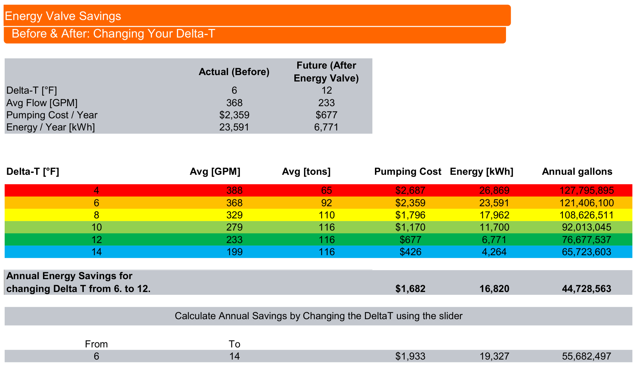
Results tab
Nothing to fill in — this is the page you show.
The slider
Set any “To” Delta-T and the savings line recalculates live. The “From” case stays pinned to the coil's actual Delta-T.
It answers “what if we only get halfway there?” live — far better than defending one optimistic number.
Above it: the before-and-after comparison and the full Delta-T range, colour-graded from worst to best.
13

Slide 19
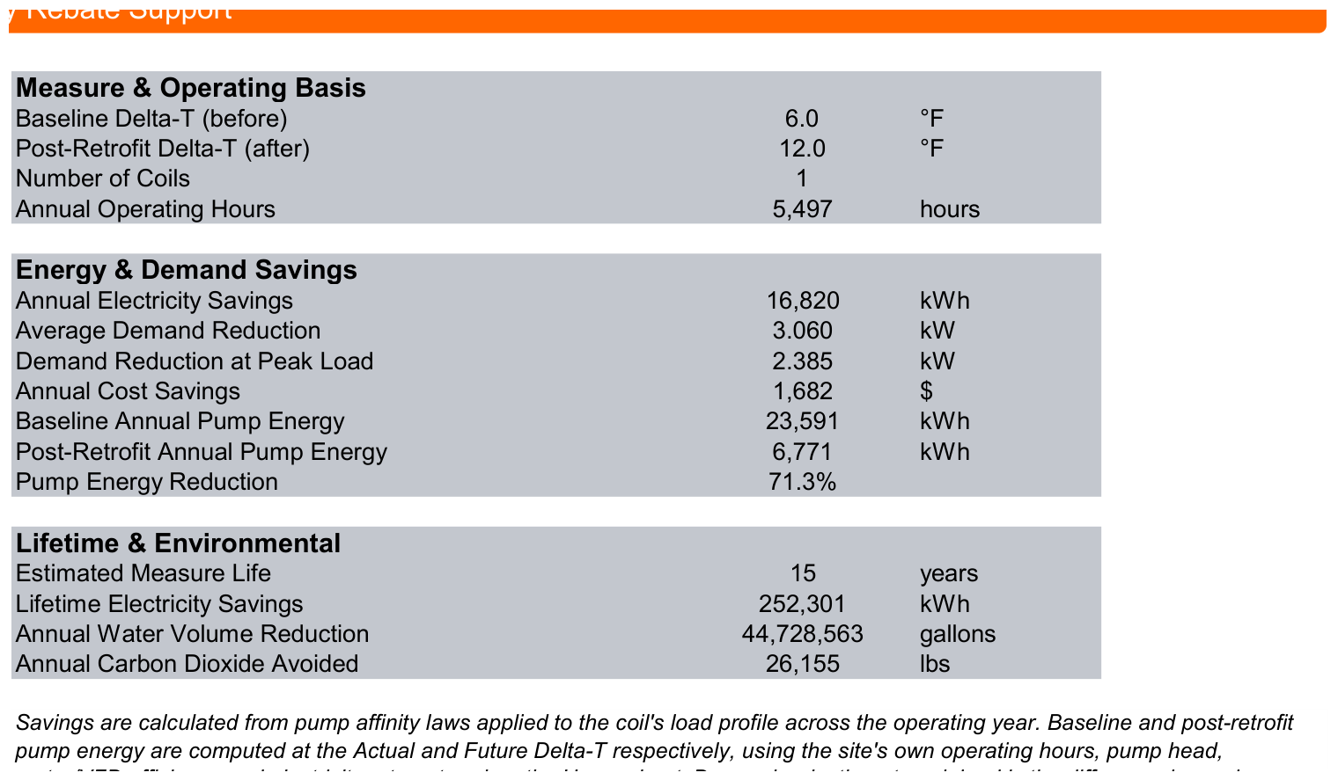
Rebate support, ready to hand over
Laid out the way incentive programmes ask for it.
Measure & operating basis
Baseline and post-retrofit Delta-T, coil count, annual hours.
Energy & demand savings
Annual kilowatt-hours, demand reduction, cost saving, percentage reduction.
Lifetime & environmental
Measure life, lifetime savings, water volume, carbon dioxide avoided.
Two demand figures — do not swap them. Average is the annual saving over annual hours. Peak is the power difference at design. Rebate forms usually want peak.
14

Slide 20
Five things that trip people up
Worth knowing before a customer asks.
1
A cell will not accept typing
It is a calculated result, not an input.
2
Savings look implausibly large
Check the Delta-T gap and the Pump Design Factor.
3
The financial results look wrong
Check the investment field holds the incremental valve cost.
4
A Delta-T entry is rejected
The tool enforces a minimum gap between Actual and Future.
5
Numbers did not change
Click away to commit the entry, or press F9.
15

Slide 21
Questions?
The full field manual — every step, every field, with screenshots — is available as a PDF alongside the workbook.
Rick Smith · Rick.Smith@us.belimo.com
Team Lead Regional Applications Consultant · maintains and enhances the tool
Belimo Americas · Energy Valve Coil Estimator

